Slide 1

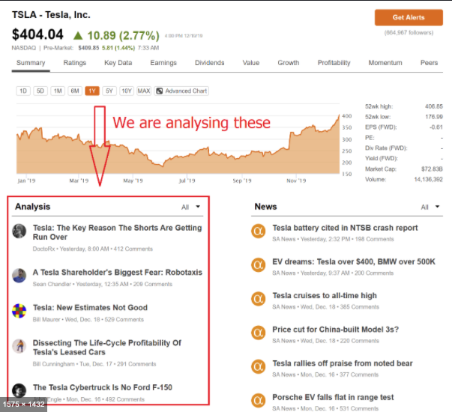
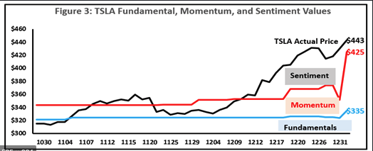


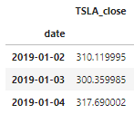
Project Overview:
Analyzing stock data in correlation to sentiments from different stock news sources and determining what (if there is any) impact it has on stock prices.
Project Team: Renae, Heena and Jatinder.
Stock Data:
Ticker: TSLA.
To limit the scope of project and create a working prototype, we decided to look at one stock initially. We picked TSLA as it seems to have more daily news and articles than many other stocks.
Stock prices source: yfinance.
We chose to use yfinance sdk to download historical stock prices as it was fairly easy to use and gave us all we needed in literally two lines of code.
Time period: year 2019 only.
We didn’t want to include 2020 as year 2020 has seen some unprecedented times and it would probably go down as an anomaly in the world history.

Slide 2
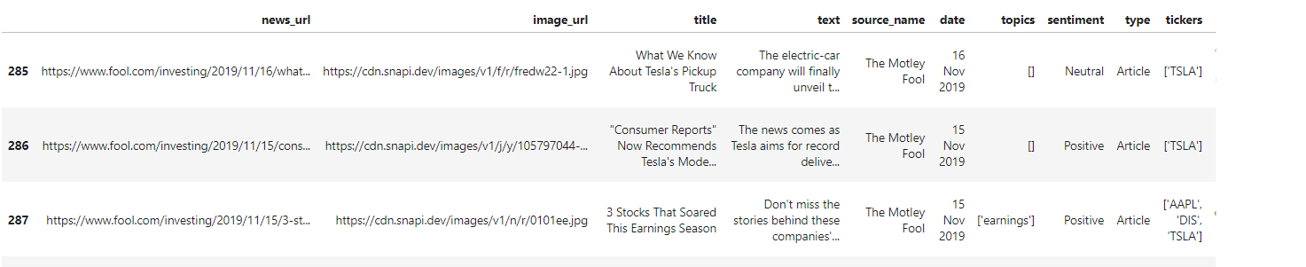
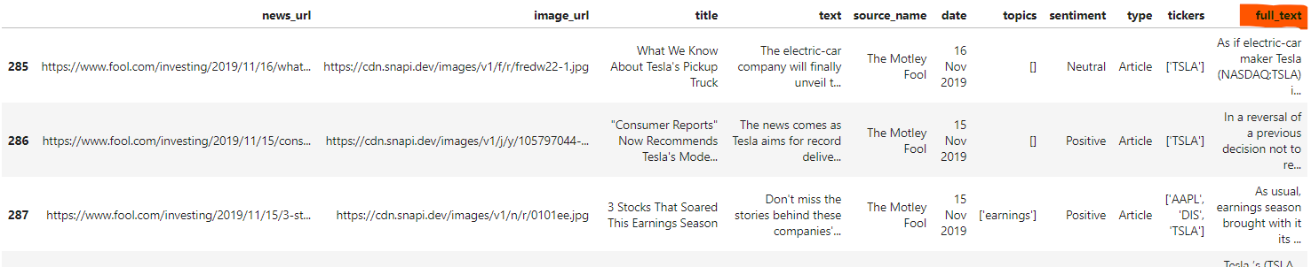
News/Articles Data:
Stock news sources: stocknewsapi.com; breakingapi.com
We downloaded the TSLA articles from stocknewsapi.com for 2019. However, stocknewsapi.com didn’t give us the full articles. It provided news URLS, headlines and snippets though. It also provided it’s own sentiment analysis score that we decided to use as a comparison to our own sentiment analysis. To get the full news articles, we wrote a custom function that would take the news url from stocknewsapi.com and pass it to breakingapi.com.
Dataframe created from data downloaded from Stocknewsapi:
Modified Dataframe after downloading full text from breakingapi.com:
Breakingapi allows to extract the full article by passing on the article link to its API. More info at https://breakingapi.com/article-extraction-api

Slide 3
Data preparation, cleaning and processing:
Extracting sentiments from TSLA articles: custom code.
Sentiment analysis is a machine learning technique that detects polarity – positive or negative - within text. The models often focus on polarity but also on emotions e.g. angry, happy, sad, etc. or even intentions, interested or not interested. We only looked at polarity, a range of positive to negative, +1 to -1.
Because our focus is on stock market returns, we looked at articles that spoke to a particular stock – Tesla in our case – and decided to see if sentiments of news articles do, in fact, have a bearing on stock prices. We only looked at the articles of 2 sources, The Motley Fool and Zacks Investment Research for the year 2019, 289 articles. Full texts of all 289 articles were processed through 2 different Sentiment Analysis Models:
VADER (Valence Aware Dictionary and sEntiment Reasoner) is a lexicon and rule-based sentiment analysis tool that is specifically attuned to sentiments in social media. This tool gives us 4 rating scores: Positive, Neutral, Negative, and Compound. Positive, Neutral, and Negative are given a ranking score within each document, with a Compound score for total polarity. The Compound score was used in our analysis.
TextBlob is a python library for processing textual data. This tool gives us 2 ratings scores: Polarity and Subjectivity. The Subjectivity scored whether the document was objectively or subjectively weighted, while the Polarity score rated the article based on positive or negative sentiment. The Polarity score was used in our analysis. Unlike VADER, input text needs to be preprocessed to tokens, because of this we ran this model twice, we wanted to see if this had any effect on the polarity and the predictive power of the sentiment:
Lemmatizer breaks the word down to its root, dropping contractions, plurals, etc.
PorterStemmer breaks the word down to its roots as does the Lemmatizer, however stemming is much stricter at stripping the words.
We also used a given polarity index from Stocknewsapi. We took this analysis at face value.
https://medium.com/@Intellica.AI/vader-ibm-watson-or-textblob-which-is-better-for-unsupervised- sentiment-analysis-db4143a39445
https://towardsdatascience.com/sentiment-analysis-vader-or-textblob-ff25514ac540

Slide 4
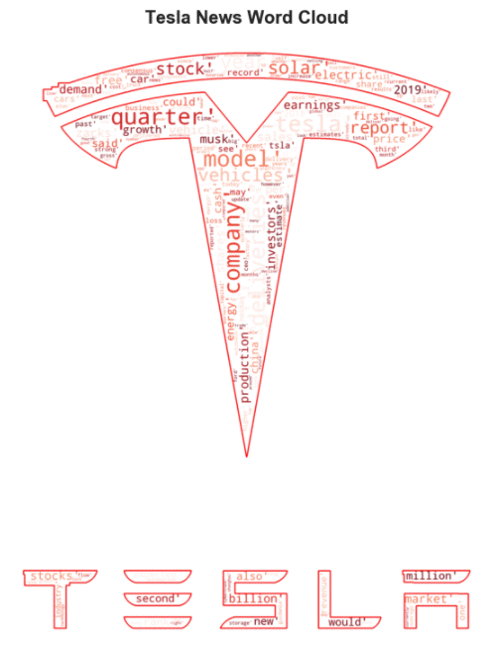
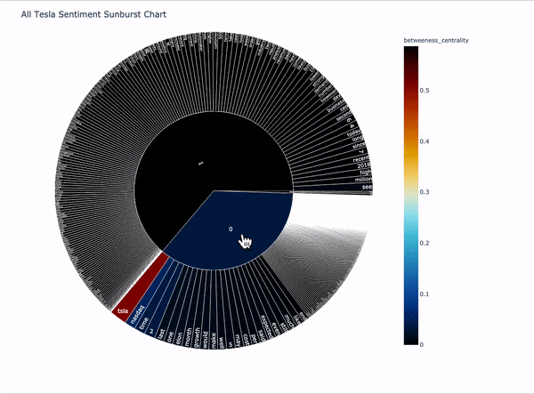
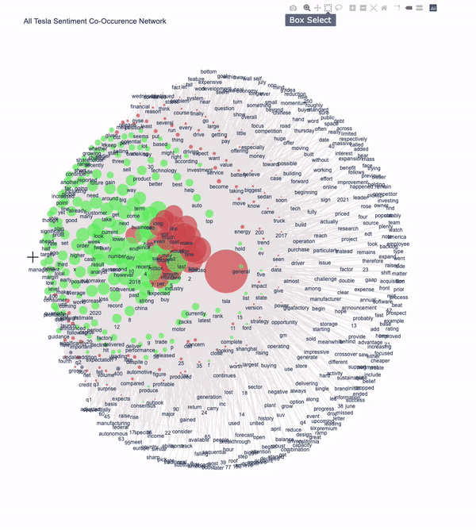
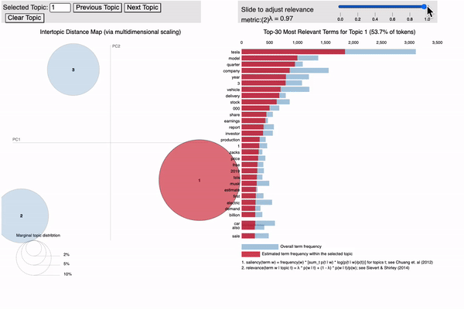
Graphs - Sentiment Analysis:

Slide 5
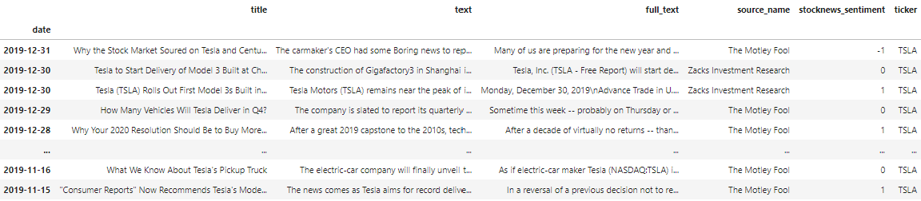
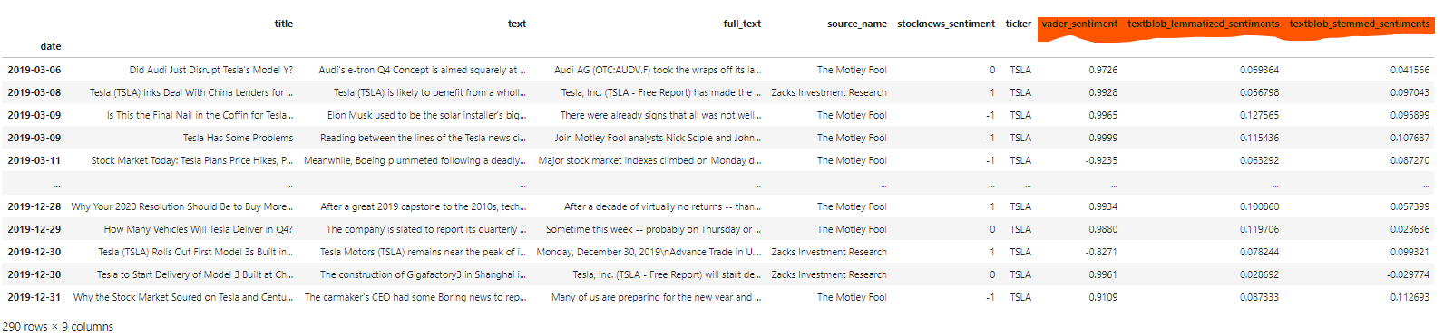
Merging stock prices and stock news sentiment data: custom code.
We created dataframes containing TSLA stock data, sentiment analysis from stocknewsapi and CSV files created by our custom code and joined them to create a final dataframe that was used for regression analysis.
Stocknewsapi sentiment translated to a numeric value:
Added sentiments from our custom code to the above dataframe:

Slide 6
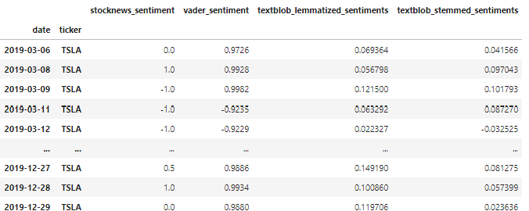
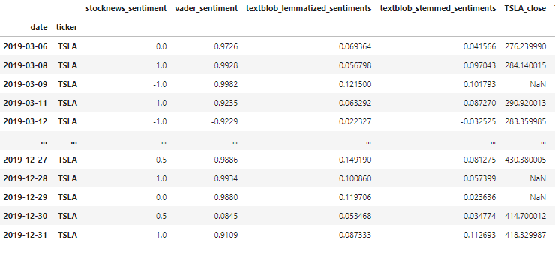
Cleaned-up dataframe containing only the columns we needed:
Merged Tesla stock closing prices for the respective dates:
*This was our Dataframe number 1 for regression analysis – grouped by date only.

Slide 7
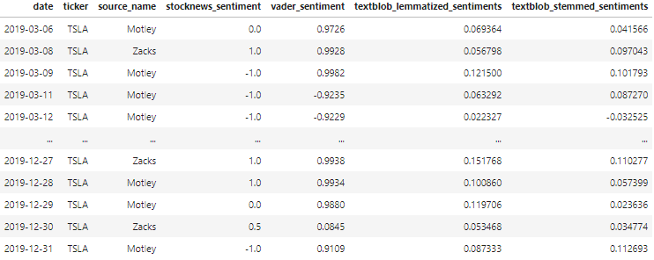
Dataframe grouped by date and source:
Source_name values transposed to columns:
.
**This was our Dataframe number 2 for regression analysis – grouped by date and source.

Slide 8

Regression Analysis:
Sentiment Analysis Data Preparation:
News articles for Tesla were not available for every trading day
Filled missing sentiment analysis with hysteresis prior to regression analysis
Monte Carlo Regression Analysis:
A monte carlo analysis was performed on 2 sentiment analysis data frames (All Sentiments and Sentiments by News Source) to determine which feature (sentiment analysis) has the best correlation to Tesla’s daily returns. The analysis was performed using two different monte carlo functions which iterated over 20 days.
Model 1: Lasso Regression
https://towardsdatascience.com/ridge-and-lasso-regression-a-complete-guide-with-python-scikit-learn-e20e34bcbf0b
Model 2: Lasso Regression using LogisticRegression
https://towardsdatascience.com/feature-selection-using-regularisation-a3678b71e499

Slide 9
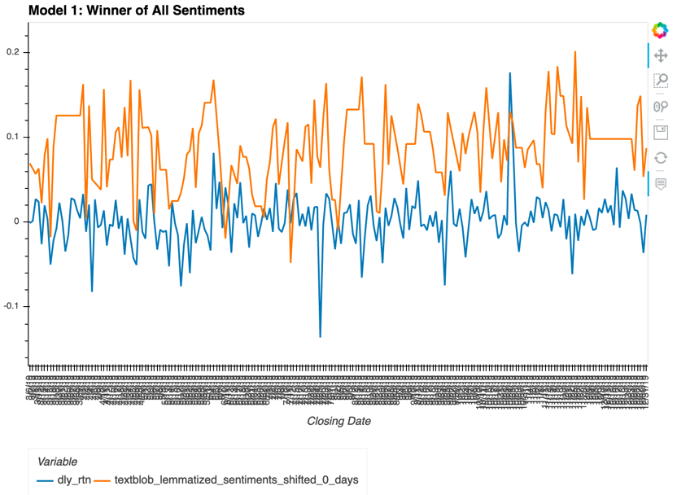
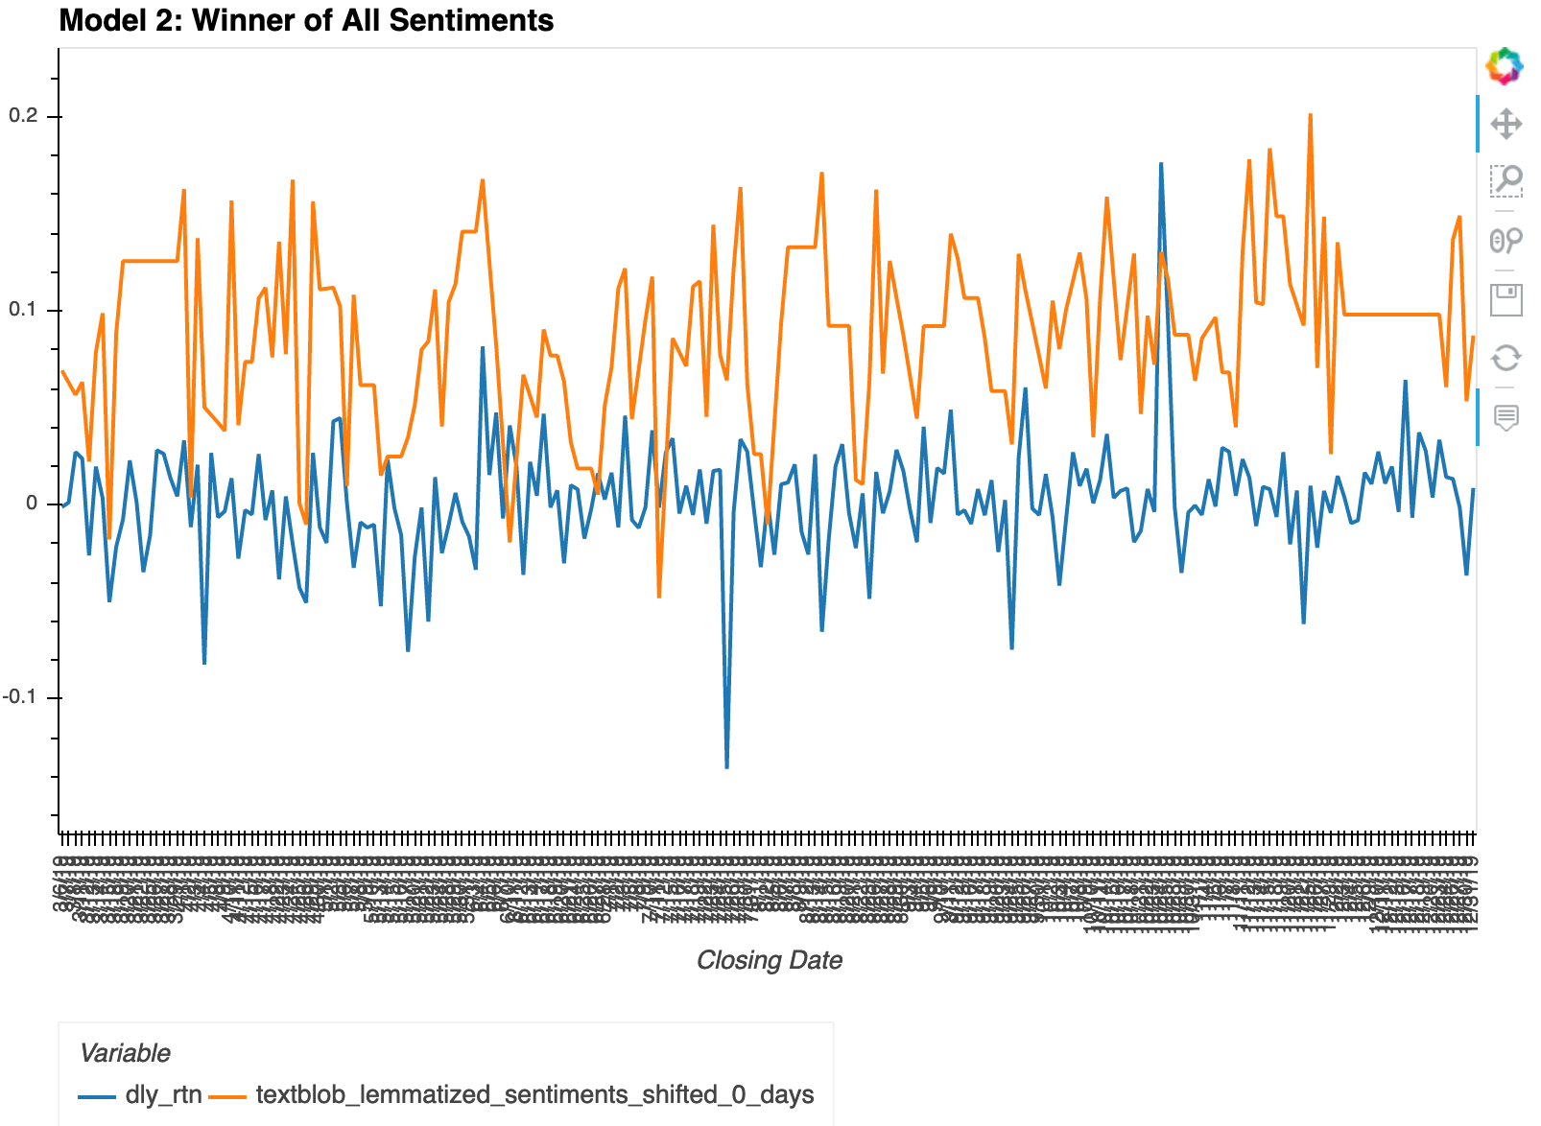
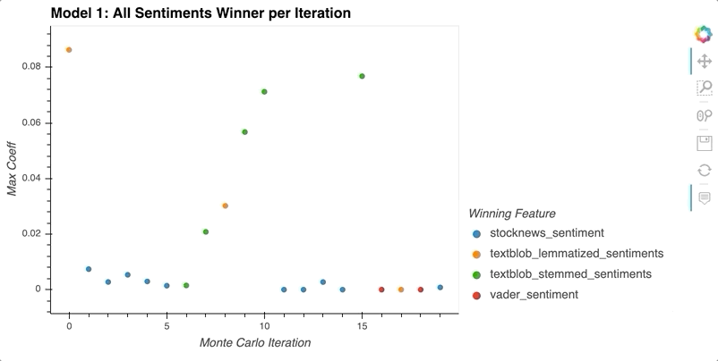
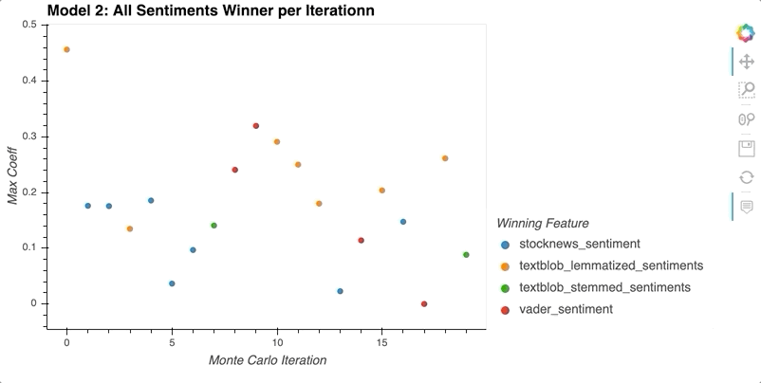
Monte Carlo Results- All Sentiments:
Model 1 (All Sentiments): Daily Returns and Textblob Lemmatized | Model 2 (All Sentiments): Daily Returns and Textblob Lemmatized
Model 1 (All Sentiments): Winner Feature per Iteration | Model 2 (All Sentiments): Winner Feature per Iteration

Slide 10
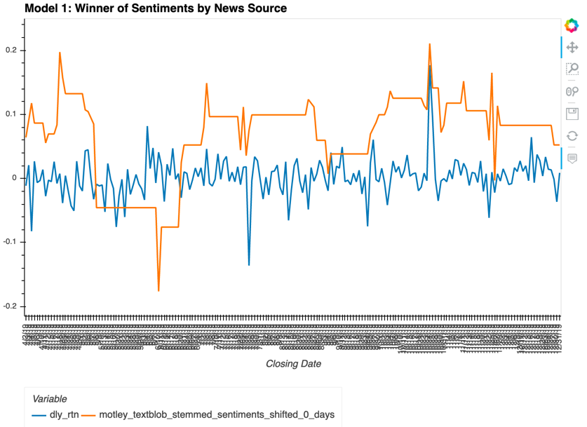
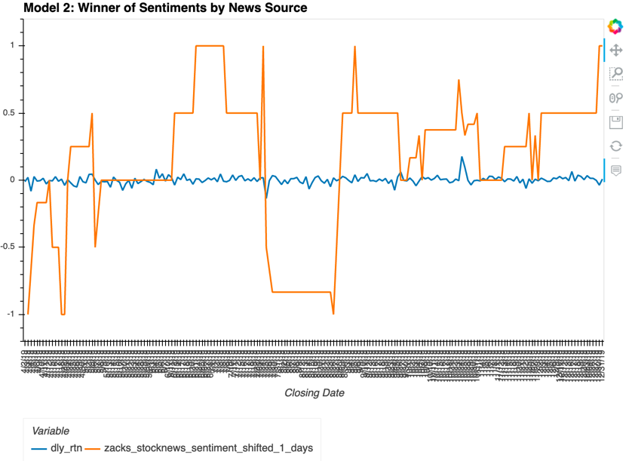
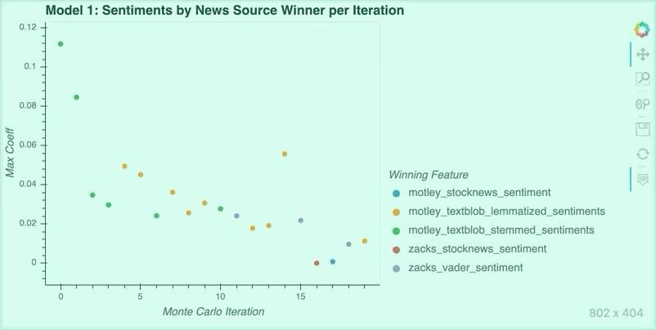
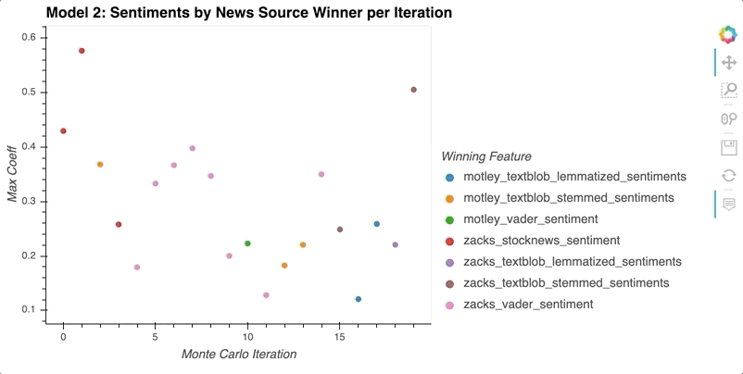
Monte Carlo Results- Sentiments by News Source:
Model 1 (Sentiments by News Source): Daily Returns and Motley Textblob Stemmed | Model 2 (Sentiments by News Source): Daily Returns and Zacks Stocknews
Model 1 (Sentiments by News Source): Winner Feature per Iteration | Model 2 (Sentiments by News Source): Winner Feature per Iteration

Slide 11

Conclusion:
From analyzing the data, we confirmed that the overall winner shown on the hvplots isn’t necessarily the feature that won the most times over the 20 day iteration. For the All Sentiment data frame, the textblob sentiment analysis has the most correlation to Tesla’s stock returns. For the Sentiment by News Source data frame, Model 1 predicts that Motley Fool has the best correlation to Tesla’s stock returns, whereas Model 2 predicts Zacks has the best correlation.
Enhancement Opportunities:
Run analysis over a longer period of time (current analysis is only for 9 months
Data mine for additional articles on stock for more sentiment analysis data
Further customization of sentiment analysis on given article
Determine if article was written for Tesla vs Tesla being mentioned in the article
Integrate volume of sales data and sell ‘type’ (industry vs retail) into regression analysis

Slide 12


